Slide 1

Linear Regression from a linear algebra perspective
Dr clyde clarke

Slide 2
Outline Learning objectives regression model best fit line Vector Representation BEST FIT (2D Model) Best FIT (3D Model) Normal Equation Examples in python
Learning Objectives:
What is the big idea?
Basics of Linear Regression (Traditional Approach)
Linear Regression from matrix algebra standpoint
The Normal Equation = Golden Equation
Use the normal equation to perform linear and quadratic regression in python
Notes:
Often linear regression is used without an understanding that it can be used to model data of varying distributions. I hope to show you how the golden equation can be used to model data of varying distributions. It’s the swiss army knife of data

Slide 3
linear Regression
Linear Regression – A model of the relationship between two variables by fitting a linear equation to observed data.
Why linear regression?
Notes:
Talk about the slide more than the words

Slide 4



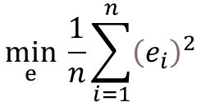


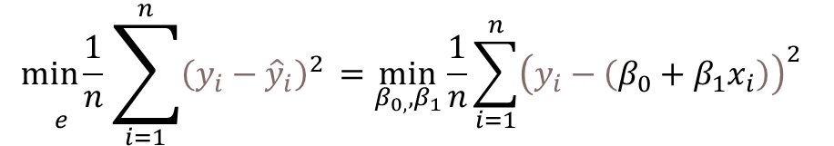
linear Regression ModeL (Traditional approach)
Features j
House Price ($ 1,000) y | House Age (years) x
405.2134 | 41.4
90.45606 | 50.1
492.2313 | 39.3
The goal is to fit a linear model to the data you observe.
$${θ:\hat{y}}_{i}=β_{0}+β_{1}x_{ij}$$
Samples i
$$e_{1}$$
$$\min_{ⅇ} \frac{1}{n}\sum_{i=1}^{n}{{\left(e_{i}\right)}^{2}}$$
$${\hat{y}}_{i}=β_{0}+β_{1}x_{i}$$
$$e_{2}$$
$$\underset{e}{min\frac{1}{n}}\sum_{i=1}^{n}{{\left(y_{i}−{\hat{y}}_{i}\right)}^{2 }=\min_{β_{0,},β_{1}}\frac{1}{n}\sum_{i=1}^{n}{{\left(y_{i}−\left(β_{0}+β_{1}x_{i}\right)\right)}^{2 } }}$$
$$e_{3}$$
Notes:
Here we see a typical regression model. Data regression equation. Minimize mean square error.

Slide 5


linear Regression Model (comparing )
The goal is to fit a linear model to the data you observe.
x | y
1 | 2
2 | -1
$$θ:\hat{y_{i}}=β_{0}$$
$$θ$$
Notes:
We saw the regression model from a typical standpoint. We want to get under the hood. In order to do that we want to are using a simplified model to show the detail

Slide 6



linear Regression Model (1 Parameter)
The goal is to fit a linear model to the data you observe
x | y
1 | 2
2 | -1
$$θ_{0}:{\hat{y}}_{i}=β_{0}$$
$$\begin{matrix}{\hat{y}}_{1}=1.5 \\ {\hat{y}}_{2}=1.5\end{matrix}$$
$$θ_{0}$$

Slide 7



linear Regression Model (1 Parameter)
The goal is to fit a linear model to the data you observe
x | y
1 | 2
2 | -1
$$θ_{1}:{\hat{y}}_{i}=β_{0}$$
$$\begin{matrix}{\hat{y}}_{1}=0.5 \\ {\hat{y}}_{2}=0.5\end{matrix}$$
$$θ_{1}$$

Slide 8
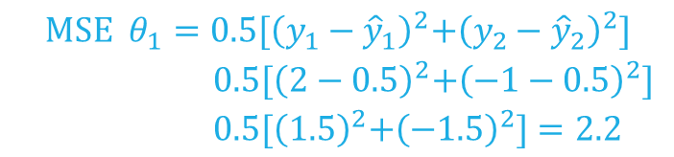
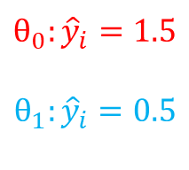
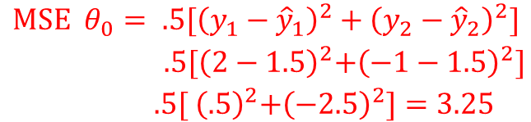
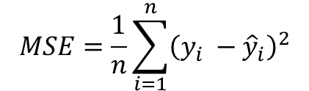


linear Regression Model
The goal is to fit a linear model to the data you observe
Which of these two models is the better model? Why?
x | y
1 | 2
2 | -1
$$θ_{0}:{\hat{y}}_{i}=1.5$$
$$θ_{1}:{\hat{y}}_{i}=0.5$$
$$MSE=\frac{1}{n}\sum_{i=1}^{n}{{\left(y_{i} −{\hat{y}}_{i}\right)}^{2}}$$
$$θ_{0}$$
.25
$$\begin{matrix}MSE{ θ}_{0}= .5[{\left(y_{1}−{\hat{y}}_{1}\right)}^{2}+{\left(y_{2}−{\hat{y}}_{2}\right)}^{2}] \\ { .5[\left(2−1.5\right)}^{2}+{\left(−1−1.5\right)}^{2}] \\ { .5[ \left(.5\right)}^{2}+{\left(−2.5\right)}^{2}]=3.25\end{matrix}$$
1.5
$$θ_{1}$$
-2.5
-1.5
$$\begin{matrix}MSE{ θ}_{1}=0.5{[\left(y_{1}−{\hat{y}}_{1}\right)}^{2}+{\left(y_{2}−{\hat{y}}_{2}\right)}^{2}] \\ { 0.5[\left(2−0.5\right)}^{2}+{\left(−1−0.5\right)}^{2}] \\ { 0.5[\left(1.5\right)}^{2}+{\left(−1.5\right)}^{2}]=2.2\end{matrix}$$

Slide 9
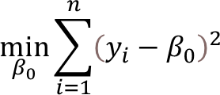




linear Regression Model
The goal is to fit a linear model to the data you observe
What is best possible model for $θ$?
x | y
1 | 2
2 | -1
$$θ:\hat{y_{i}}=β_{0}$$
$$θ_{best }$$
$\begin{matrix} \\ \frac{∂}{∂βo}\left[{\left(y_{1}−β_{0}\right)}^{2}+{\left(y_{2}−β_{0}\right)}^{2}\right] \\ \end{matrix}$ = 0
$−$2($y_{1}$ $−$ $β_{0}$) $−$2($y_{2}$ $−$ $β_{0}$) = 0
$β_{0}$ = $\frac{y_{1} + y_{2}}{2}$ = $\frac{2+(−1)}{2}$ = $\frac{1}{2}$

Slide 10
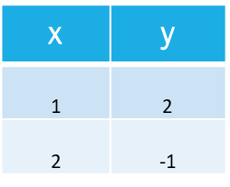
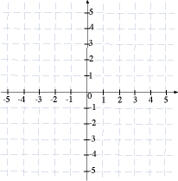


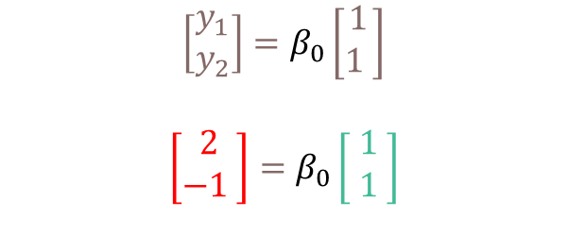

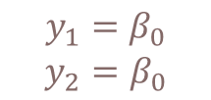



Linear regression Model (2D Vector Representation)
The goal is to fit the linear model $θ$ to the data you observe
Let us rewrite our regression problem a system of linear equations
$$θ:\hat{y_{i}}=β_{0}$$
$$y_{i}={\hat{y}}_{i}$$
$$\left[\begin{aligned}1 \\ 1\begin{matrix} \\ \end{matrix}\end{aligned}\right]$$
$$\begin{matrix}y_{1}=β_{0} \\ y_{2}=β_{0}\end{matrix}$$
$$\left[\begin{matrix}y_{1} \\ y_{2}\end{matrix}\right]=β_{0}\left[\begin{aligned}1 \\ 1\begin{matrix} \\ \end{matrix}\end{aligned}\right]$$
$$\left[\begin{aligned}2 \\ −1\begin{matrix} \\ \end{matrix}\end{aligned}\right]=β_{0}\left[\begin{aligned}1 \\ 1\begin{matrix} \\ \end{matrix}\end{aligned}\right]$$
$$\left[\begin{matrix}2 \\ −1\end{matrix}\right]$$
Notes:
We can represent the best fit model using an equivalent vector representation. We are now going to use vectors to solve the same problem. This view is advantageous

Slide 11






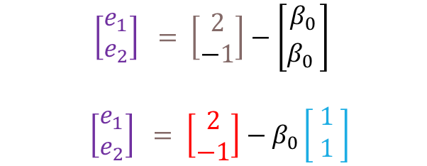

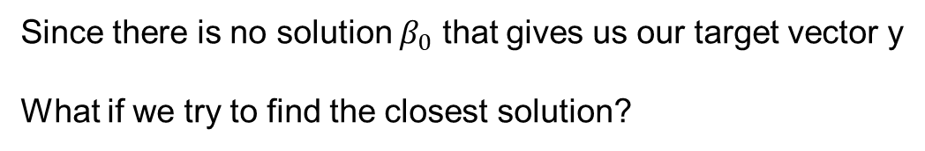
Linear regression Model (2D Vector Representation)
$$y_{2}$$
Since there is no solution $β_{0}$ that gives us our target vector y
What if we try to find the closest solution?
$\left[\begin{matrix}e_{1} \\ e_{2}\end{matrix}\right] = \left[\begin{matrix}2 \\ −1\end{matrix}\right]−\left[\begin{aligned}β_{0} \\ β_{0}\begin{matrix} \\ \end{matrix}\end{aligned}\right]$
$\left[\begin{matrix}e_{1} \\ e_{2}\end{matrix}\right] = \left[\begin{matrix}2 \\ −1\end{matrix}\right]−β_{0}\left[\begin{aligned}1 \\ 1\begin{matrix} \\ \end{matrix}\end{aligned}\right]$
$$β_{0}l$$
$$e$$
We want to find a $β_{0}$that minimizes the length of the vector $e$
$$y_{1}$$
$$\left\|\vec{e}\right\|=\sqrt{e_{1}^{2}+e_{2}^{2}}$$
$$y$$
e $=y−β_{0}l$
Notes:
Minimizing the length of the vector is equivalent to finding the minimum length of the vector e

Slide 12


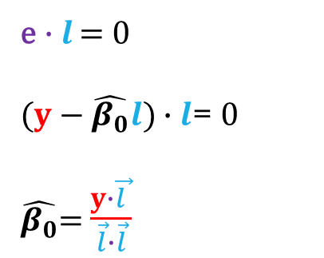
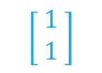





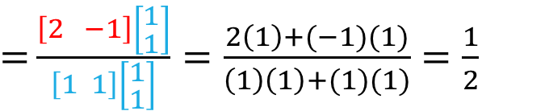
Linear regression
y
Find a vector $\hat{β_{0}}l$that is closest to our $y$
$$\hat{β_{0}}l$$
We want to find a $\hat{β_{0}}$ that minimizes the length of the vector $\vec{e}$
$$\left[\begin{aligned}1 \\ 1\begin{matrix} \\ \end{matrix}\end{aligned}\right]$$
$$e=y−\hat{β_{0}}l$$
$$\hat{β_{0}}l$$
$$e$$
The length of $\vec{e}$ is minimized when it is perpendicular to $l$
$$y_{1}$$
$$y$$
e$∙l$ = 0
$\text{(}y−\hat{β_{0}}l\text{)}∙l$= 0
$\hat{β_{0}}$= $\frac{y∙\vec{l }}{\vec{l}∙\vec{l}}$
$$\left[\begin{matrix}2 \\ −1\end{matrix}\right]$$
$=$ $\frac{\left[2 −1\right]\left[\begin{aligned}1 \\ 1\end{aligned}\right]}{\left[1 1\right]\left[\begin{aligned}1 \\ 1\end{aligned}\right]}=\frac{2\left(1\right)+(−1)(1)}{\left(1\right)\left(1\right)+(1)(1)}$ $=\frac{1}{2}$

Slide 13
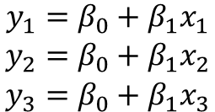

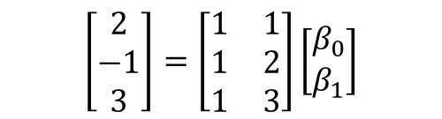

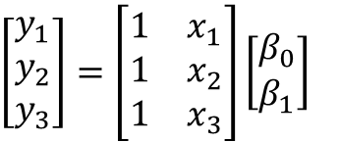
linear Regression Model (matrix Formula)
The goal is to fit the model to the data we observe
x | y
1 | 2
2 | -1
3 | 3
$${θ:\hat{y}}_{i}=β_{0}+β_{1}x_{i}$$
Samples i
1) Set our target variable equal to our estimate
$$y_{i}={\hat{y}}_{i}$$
2) Rewrite as a system of linear equations
$$\begin{matrix}y_{1}=β_{0}+β_{1}x_{1} \\ y_{2}=β_{0}+β_{1}x_{2} \\ y_{3}=β_{0}+β_{1}x_{3}\end{matrix}$$
$\left[\begin{matrix}y_{1} \\ y_{2} \\ y_{3}\end{matrix}\right]=\left[\begin{matrix}1 & x_{1} \\ 1 & x_{2} \\ 1 & x_{3}\end{matrix}\right]\left[\begin{matrix}β_{0} \\ β_{1}\end{matrix}\right]$
$$\left[\begin{matrix}2 \\ −1 \\ 3\end{matrix}\right]=\left[\begin{matrix}1 & 1 \\ 1 & 2 \\ 1 & 3\end{matrix}\right]\left[\begin{matrix}β_{0} \\ β_{1}\end{matrix}\right]$$

Slide 14
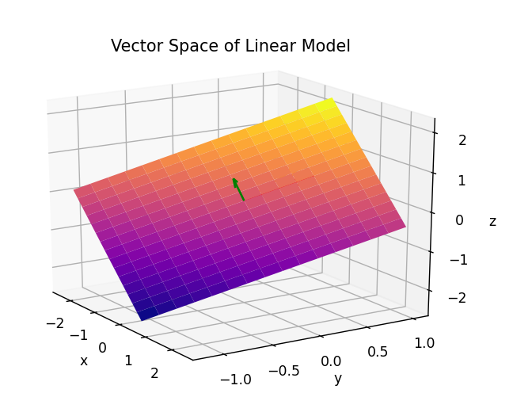
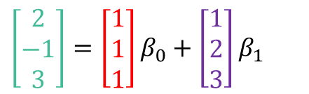

linear Regression Model (Vector Representation 3D)
x | y
1 | 2
2 | -1
3 | 3
We want to find the values of $β_{0}$and $β_{1}$ that will solve
$y$ = A$β$
$$\left[\begin{matrix}2 \\ −1 \\ 3\end{matrix}\right]=\left[\begin{matrix}1 & 1 \\ 1 & 2 \\ 1 & 3\end{matrix}\right]\left[\begin{matrix}β_{0} \\ β_{1}\end{matrix}\right]$$
We can rewrite the rhs as a linear combination
of the column vectors of A
y $=$ ${a_{1}β}_{0}$ + $a_{2} β_{1}$
$\left[\begin{matrix}2 \\ −1 \\ 3\end{matrix}\right]=\left[\begin{aligned}1 \\ 1 \\ 1\end{aligned}\right]β_{0}$ + $\left[\begin{aligned}1 \\ 2 \\ 3\end{aligned}\right]β_{1}$

Slide 15





Geometric interpretation
We would like to find an approximate solution to the equation
y is the target vector
A is the Design Matrix
$β$ is our parameter vector
A = $\left[\begin{matrix}1 & x_{1} \\ 1 & x_{2} \\ 1 & x_{3}\end{matrix}\right]$, $y$ = $\left[\begin{aligned}y_{1} \\ y_{2} \\ y_{3}\end{aligned}\right]$, $β =\left[\begin{aligned}β_{0} \\ β_{1}\begin{matrix} \\ \end{matrix}\end{aligned}\right]$
$y$ = A$β$
$\left[\begin{matrix}y_{1} \\ y_{2} \\ y_{3}\end{matrix}\right]\text{=}\left[\begin{matrix}1 & x_{1} \\ 1 & x_{2} \\ 1 & x_{3}\end{matrix}\right]\left[\begin{aligned}β_{o} \\ β_{1}\begin{matrix} \\ \end{matrix}\end{aligned}\right]$
y = ${a_{1}β}_{0}$ + $a_{2} β_{1}$
$$y$$
$$\left\|y−Aβ\right\|$$
$$β_{0}a_{1}+β_{1}a_{2}=Aβ$$

Slide 16
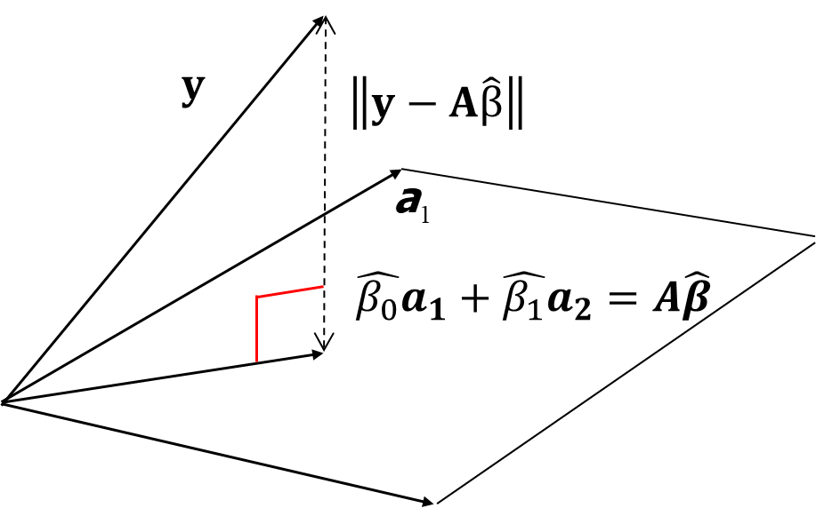
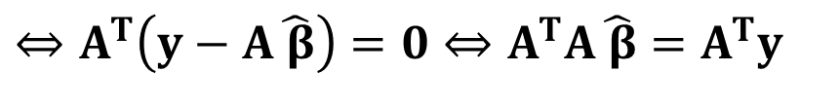
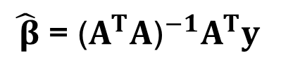

Geometric interpretation (Normal Equation)
min$\left\|y−A\hat{ β}\right\|$
$$⇔A^{T}\left(y−A\hat{ β}\right)=0⇔A^{T}A\hat{ β}=A^{T}y$$
$\hat{ β}$ = ${\text{(}A^{T}A\text{)}}^{−1}A^{T}y$

Slide 17
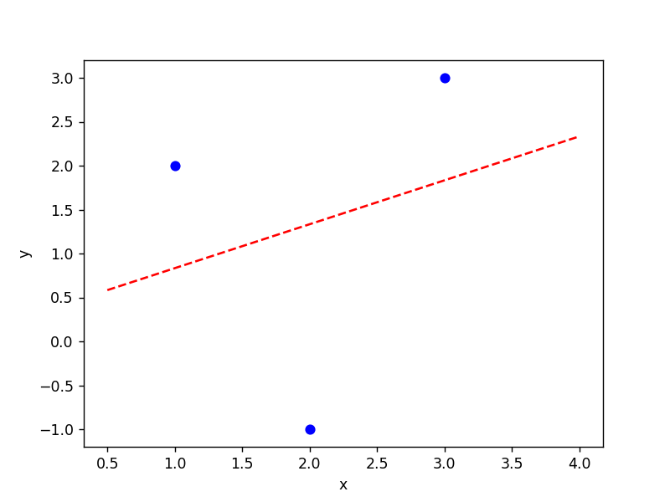
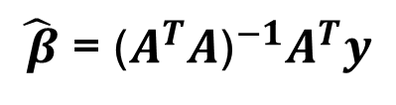



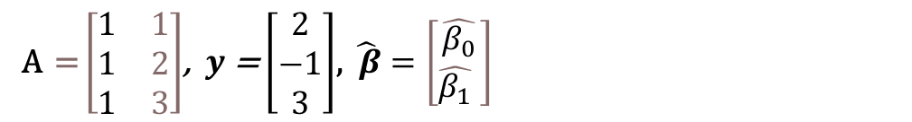
Solving The normal equation:
x | y
1 | 2
2 | -1
3 | 3
$\hat{ β}$ = ${\text{(}A^{T}A\text{)}}^{−1}A^{T}y$
Goal is use our design matrix A and the normal equation
A = $\left[\begin{matrix}1 & 1 \\ 1 & 2 \\ 1 & 3\end{matrix}\right]$, $y$ = $\left[\begin{aligned}2 \\ −1 \\ 3\end{aligned}\right]$, $\hat{ β}=\left[\begin{aligned}\hat{β_{0}} \\ \hat{β_{1}}\begin{matrix} \\ \end{matrix}\end{aligned}\right]$
$${θ:\hat{y}}_{i}=β_{0}+β_{1}x_{i}$$
$\hat{ β}$ =${\left(\left[\begin{matrix}1 & 1 & 1 \\ 1 & 2 & 3\end{matrix}\right]\left[\begin{matrix}1 & 1 \\ 1 & 2 \\ 1 & 3\end{matrix}\right]\right)}^{−1}\left[\begin{matrix}1 & 1 & 1 \\ 1 & 2 & 3\end{matrix}\right]$ $\left[\begin{aligned}2 \\ −1 \\ 3\end{aligned}\right]$
$\hat{ β}$ =${ \left[\begin{matrix}3 & 6 \\ 6 & 14\end{matrix}\right]}^{−1}\left[\begin{aligned}4 \\ 9\end{aligned}\right]$ = $\left[\begin{aligned}\frac{1}{3} \\ \frac{1}{2}\end{aligned}\right]$
$${\hat{y}}_{i}=\frac{1}{3}+\frac{1}{2}x_{i}$$

Slide 18
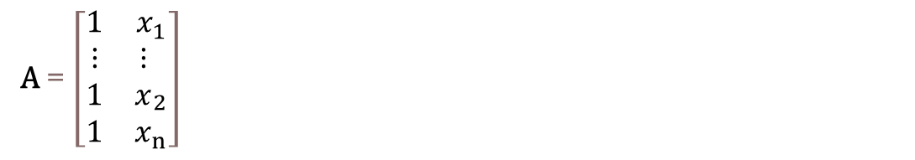
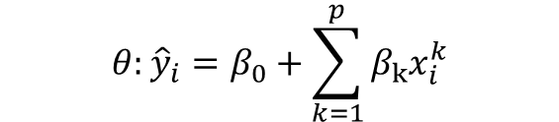
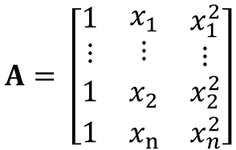

Polynomial regression (construct design matrix)
We start with a general model equation:
$${θ:\hat{y}}_{i}=β_{0}+\sum_{k=1}^{p}{β_{k}x_{i}^{k}}$$
p+1
Linear Model p = 1
A = $\left[\begin{matrix}1 & x_{1} \\ \begin{aligned}⋮ \\ 1\end{aligned} & {\begin{aligned}⋮ \\ x\end{aligned}}_{2} \\ 1 & x_{n}\end{matrix}\right]$
$${θ:\hat{y}}_{i}=β_{0}+β_{1}x_{i}$$
n – number of rows in your data
p+1
Linear Model p = 2
$$A= \left[\begin{matrix}\begin{aligned}1 \\ ⋮\end{aligned} & \begin{aligned}x_{1} \\ ⋮\end{aligned} & \begin{aligned}x_{1}^{2} \\ ⋮\end{aligned} \\ 1 & x_{2} & x_{2}^{2} \\ 1 & x_{n} & x_{n}^{2}\end{matrix}\right]$$
$${θ:\hat{y}}_{i}=β_{0}+β_{1}x_{i }+β_{2}x_{i}^{2}$$
n – number of rows in your data

Slide 19

Limitations to normal equation
In order to use the normal equation we must compute
This is computationally intensive O(n^3)
Typically if n is greater than 10,000 other methods should be considered
$${\text{(}A^{T}A\text{)}}^{−1}$$

Slide 20
Glossary of terms
DOT PRODUCT
LINEAR CONBINATION
SPAN
COLUMN SPACE
Lecture slides and resources can be found at https://github.com/cclarke411/linearalgebra

